Slide 1
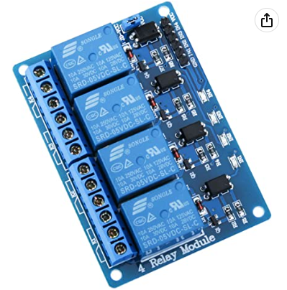
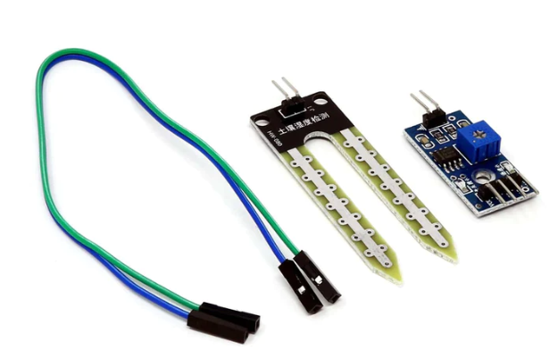
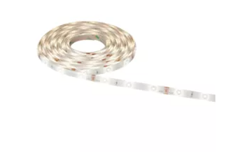
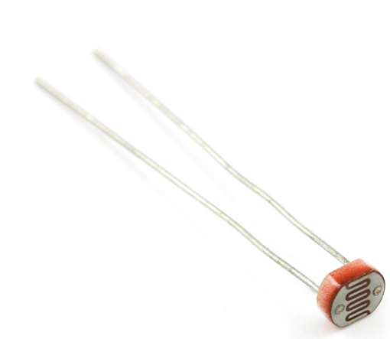
Items involved
Raspberry PI
Relay module (4 ports but only 2 used)
Soil moisture sensors (2) https://thepihut.com/products/soil-moisture-sensor
Led stripe
Light sensor and capacitor

Slide 2
The program activates the moisture sensors by switching on the corresponding line in the relay. This avoids corrosion/electrolysis. The digital value of the sensor is read and if the soil is too dry an email is sent with the values of each sensor.
The amount of light is tested with the light sensor. This is done the hard way, using a capacitor (instead of a pre-built module). If the light is below a certain limit, the led strip is switched on activating the second line in the relay.
The article (origin: https://iot4beginners.com/measure-the-intensity-of-light-using-a-photocell/) shows the original process.

Slide 3
PIN mapping
1 (3V) – provide power to the photocell
29 (GPIO) – is set to high when the capacitor is fully charged
2 (5V) – provides power to the relay set
5 (5V) – provides power to the moisture sensors (via relay switch)
6 (GND) – collects the grounds of all the devices (except the relay box)
9 (GND) – ground of the relay box
7 – relay pin to switch on the moisture sensors
11 – relay pin to switch on the led strip
8 / 16 – pin to collect the reading from the moisture sensor (they read the digital value)
The second relay switch is powered externally (12V) to provide power to the led strips

